Slide 1
Glycolysis

Slide 2
Notes before we start
Excellent work on the News and Discussions!
Post suggestions/typos about readings to “Background Reading Suggestions” page
Don’t forget to make use of the vocabulary page!

Slide 3
Graded Quiz Question #1
How does insulin help glucose enter an adipocyte?
Active transport through GLUT1
Active transport through GLUT4
Passive transport through GLUT1
Passive transport through GLUT4

Slide 4
Graded Quiz Question #2
Which enzyme has a Km for glucose near the physiological range:
Glucokinase
Hexokinase
Phosphofructokinase
GLUT4
Notes:
Answer is glucokinase

Slide 5
Graded Quiz Question #3
Which of the following is a target of glucagon dependent PKA phosphorylation in the liver?
GLUT2
PFK1
PFK2
Hexokinase
Notes:
Answer is PFK2

Slide 6
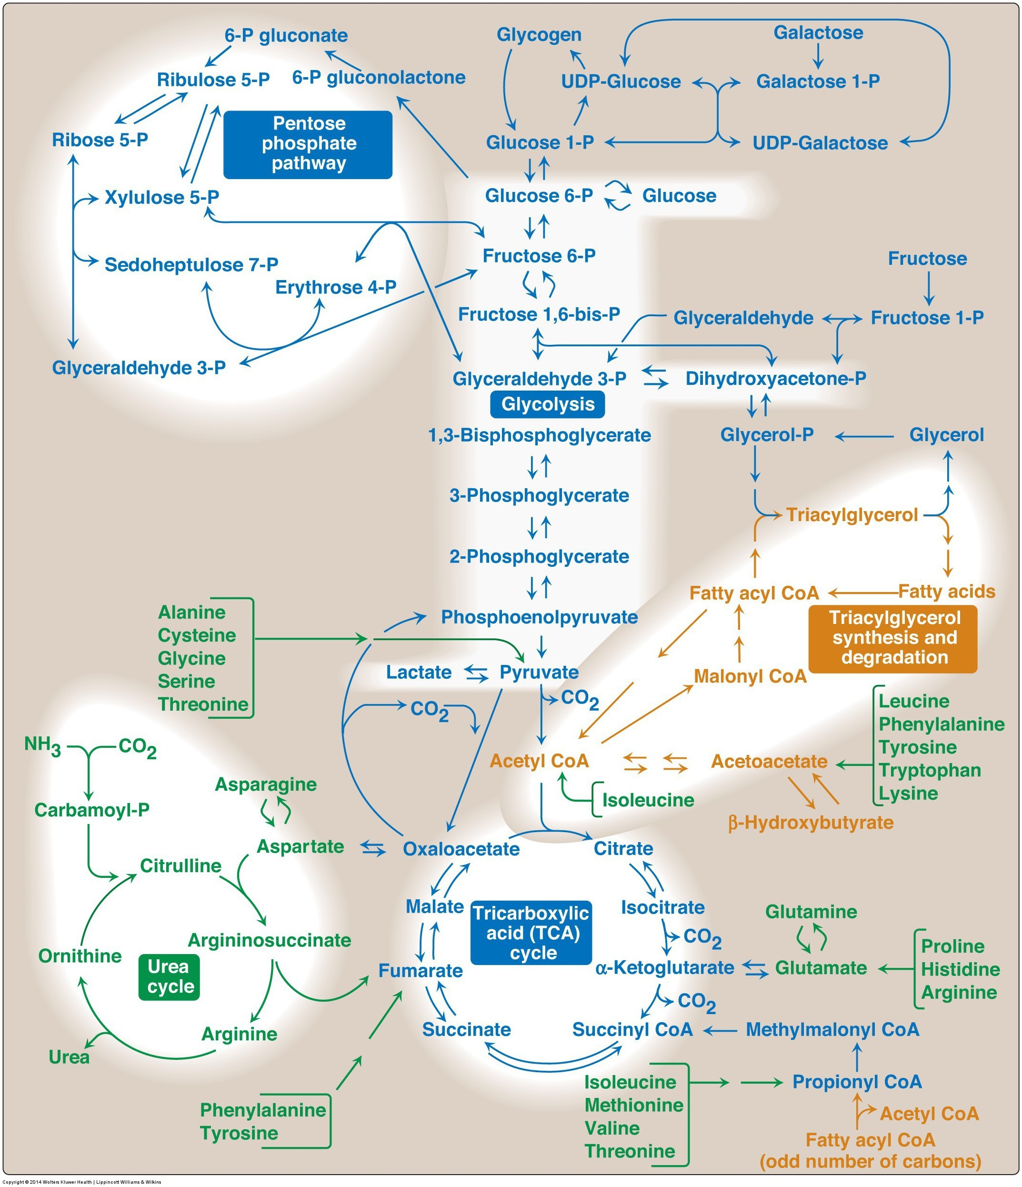
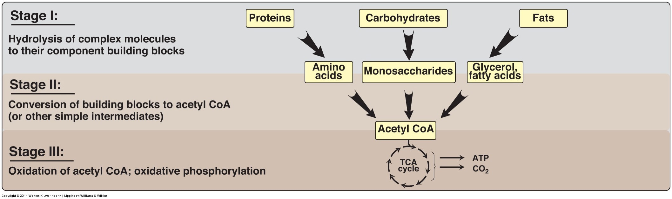
CHO Metabolism Overview
Sep 25: Glycolysis Sep 27: TCA Cycle and the Electron Transport Chain Oct 2: Glycogen Metabolism and the Pentose Phosphate Shunt Oct 4: Gluconeogenesis Oct 9: In-Class Review Oct 11: Exam 1

Slide 7
Glycolysis Learning Objectives
Describe the relative roles of glycolysis, gluconeogenesis, the TCA cycle as central nodes of nutrient metabolism.
Explain the enzymatic differences and tissue distributions of glucokinase vs hexokinase and why this is important.
Understand how ATP is produced from glycolysis, and the efficiency of aerobic vs non-aerobic glycolysis
Understand the key points of regulation of glycolysis and how these regulatory points are controlled, notably how glucokinase/hexokinase, PFK1 and PK are regulated including what signals are important in which tissues.
Describe the potential fates of pyruvate, and what dictates the next steps in its metabolism
Explain how non-glucose carbohydrates such as galactose and fructose enter glycolysis, and how their point of entry affects how they are regulated.

Slide 8
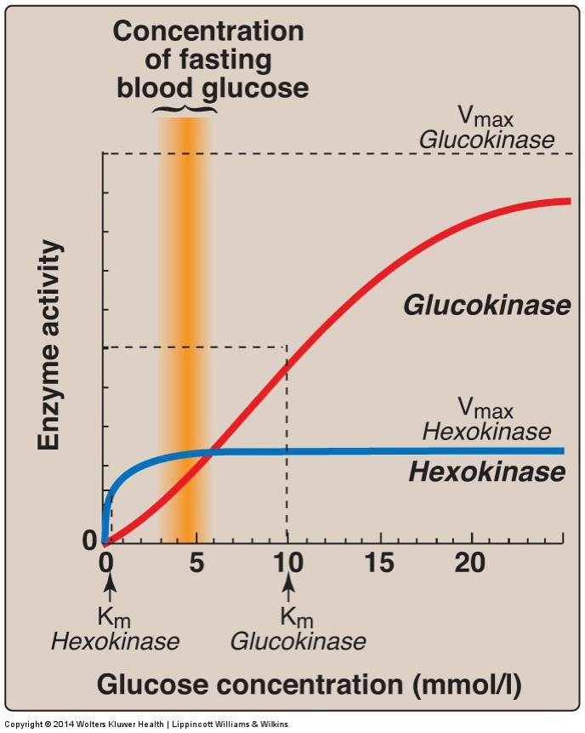
Glucokinase vs Hexokinase
Enzyme | Tissue | Regulation | Kinetics
Glucokinase | Liver/Pancreas |  | Co-operative/Fast
Hexokinase | Fat/Muscle | -G6P | High Affinity

Slide 9
Fates of Glucose-6-Phosphate
GS: Glycogen syntase
PFK1: Phosphofructokinase 1
G6PDH: G6P Dehydrogenase

Slide 10
Staring with the End – What happens to the Pyruvate
Aerobic Conditions
Becomes Acetyl-CoA
In presence of CHO but need energy -> TCA Cycle
In presence of CHO but don’t need energy -> Lipids
In absence of CHO
Ketone Bodies (if OAA absent)
Gluconeogenesis (if OAA present)
Anaerobic conditions
Becomes lactate
Lactate goes to liver for reconversion back to glucose
Notes:
Absent of CHO is mo

Slide 11
Glycolysis Net ATP
Glycolysis
Uses 2 ATP (GK/HK and PFK1) -2ATP
Generates 2 DHAP/Ga3P Each of which:
Generates 2 ATP -> +4 ATP total
Generates 1 NADH -> +5 ATP (2.5 ATP/NADH) total
Net to Pyruvate-> 5 + 4 – 2 = 7 ATP
Net to Lactate
Generates 1 more NADH for each pyruvate -> +2 ATP
Through TCA/ETC ~ 32 ATP

Slide 12
Practice Exercises
Be able to calculate (and justify) the energy produced from aerobic or anaerobic oxidation of:
Glucose
Galactose
Fructose
Glycerol (uses 1 ATP, makes 1 NADH to get to DHAP/Ga3P)

Slide 13
Case Study – Tarui’s Disease
Mutation in phosphofructokinase 1
Rare ~100 cases
Autosomal recessive disease
Spend a moment thinking what would be the results of this disease

Slide 14
Case Study – Tarui’s Disease
Mutation in phosphofructokinase 1
Discuss some of these aspects among small groups
How would this affect the ability to use glucose for energy?
What would happen to glycogen levels?
What energy sources would be used instead?
What would happen to Fructose-2,6-bisphosphate levels?
Would it affect fructose utilization?

Slide 15
How would this affect the ability to use glucose for energy?
Would make it difficult
Would make it easy
Would have no effect

Slide 16
What would happen to glycogen levels?
More glycogen
Less glycogen
The same amount

Slide 17
What energy sources would be ok?
Fructose, Lipids and Amino Acids
Lipids and Amino Acids
Only Lipids
Only Amino Acids

Slide 18
Case Study – Tarui’s Disease
Mutation in phosphofructokinase 1 in muscle only
Discuss some of these aspects among small groups
How would this affect muscle function?
Would this be different from a mutation in the liver PFK1 enzyme?
What would you recommend for treatment

Slide 19
Tarui’s Disease Summary
Symptoms | Treatments
Glycogen accumulation (GSDVII) | Genetic testing
Muscle pain and cramps | Avoid anaerobic exercise
Muscle tissue degradation | Low glucose/galactose
Low muscle tone (hypotonia) | High protein diets
Cardiomyopathy

Slide 20
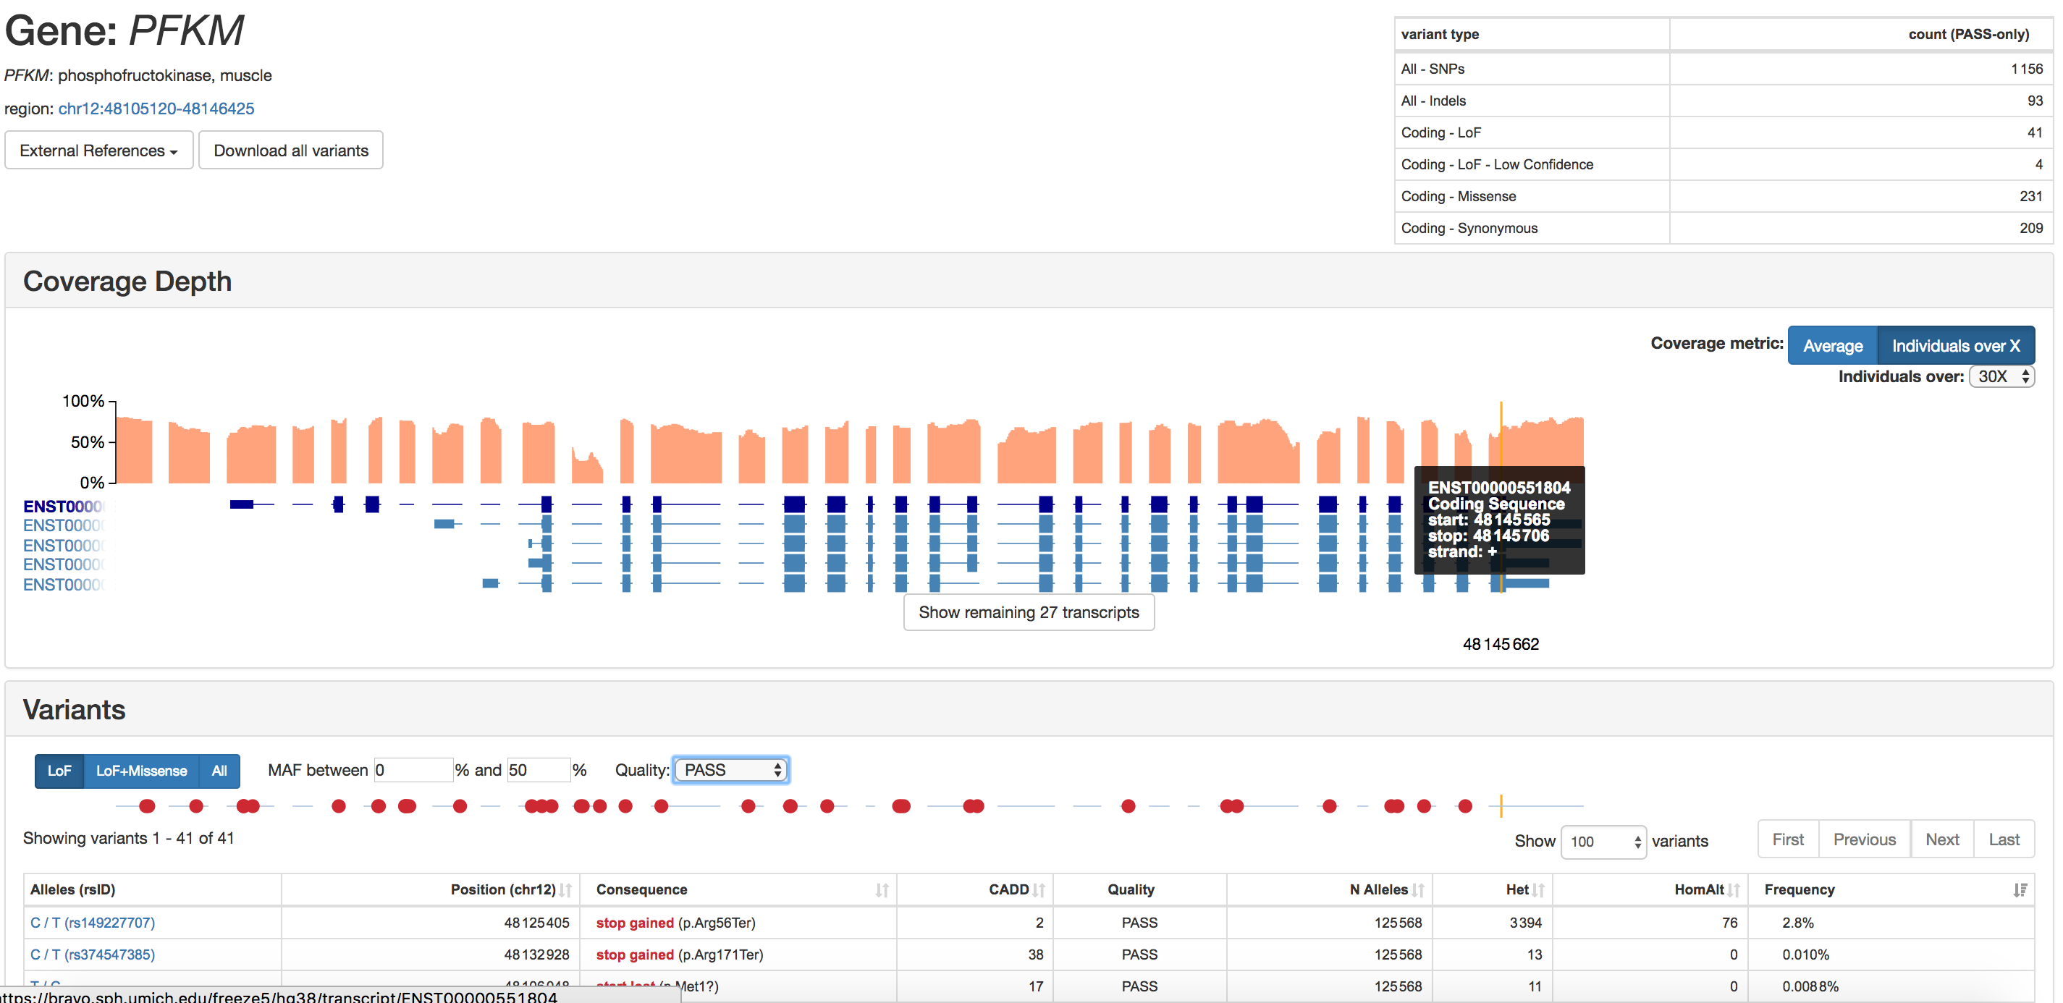
Uncommon… or is it?
2.8% frequency (8.6% in African population)
Only ~100 cases diagnosed
76/62784 homozygous individuals -> 1:826
Explore other variants on bravo.sph.umich.edu

Slide 21
Tissue Specific Roles of Glycolysis
Notes:
Be here at 2:20

Slide 22
How does glucagon/adrenaline inhibit PFK-2 activity in liver not muscle
Muscle doesn’t have PFK-2 activity
Glucagon/Adrenaline do not activate PKA in muscle
Muscle PFK-2 can’t be phosphorylated by PKA
There are no Glucagon/Adrenaline receptors in muscle

Slide 23
Glucagon and adrenaline suppress glycolysis
Why would this be useful in the liver?
Why would this be counterproductive in the muscle?
Glucagon
Adrenaline
Liver
Glycolysis
Muscle
Glycolysis
This is done by phosphorylation and inactivation of PFK2 by cAMP/PKA signaling

Slide 24
Tissue Specificity in PFK2 Regulation
Glucagon/Adrenaline can phosphorylate and inhibit Liver PFK2 but not Muscle PFK2
PFK-2 isoforms
Pourquoi?

Slide 25
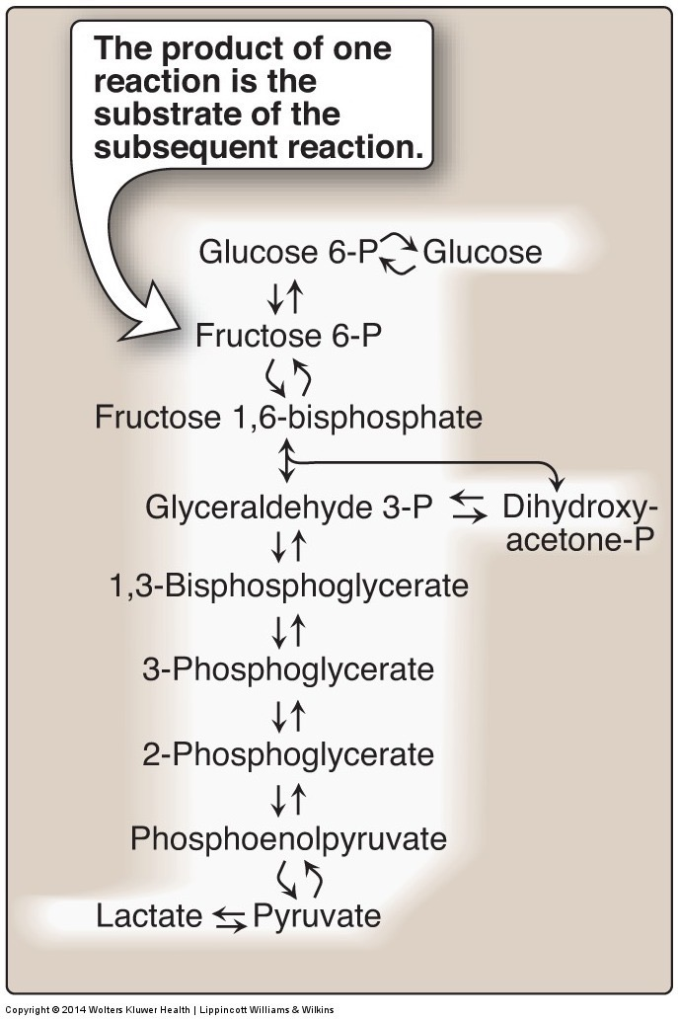
The third regulated step in glycolysis is Pyruvate Kinase
Substrate mediated ADP phosphorylation
Notes:
Other example of substrate mediated phosphorylation is phosphoglycerate kinase

Slide 26
Pyruvate Kinase is Regulated by ATP, Fructose-1,6-bisphosphate and Alanine Levels
ATP – less glycolysis when energy levels are high
F16bP – more glycolysis when buildup of upstream substrates
Alanine – less glycolysis when abundance of amino acids

Slide 27
The Important Role of Alanine
Alanine is an important amino acid catabolite
Many amino acids degrade to alanine
All but Gly, Ser and Thr

Slide 28
Post-Translational Regulation of Pyruvate Kinase
Glucagon and
Adrenaline in the Liver

Slide 29
Tissue Specific Regulation of Glycolysis Summary
Component | Liver | Muscle
Glucokinase/Hexokinase | Not inhibited by G6P | Inhibited by G6P
Phosphofructokinase | Inhibition of PFK-2 (regulates via F26bP) | PFK-2 not inhibited by phosphorylation
Pyruvate Kinase | Inhibition of PK by alanine and by phosphorylation | PK not inhibited by alanine or phosphorylation

Slide 30
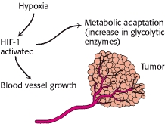
Chronic Regulation of GK/HK, PFK1 and PK Promotes Glycolysis
Hypoxia (HIF)
Carbohydrate levels (ChREBP – L-PK)
Chronic glucagon (CREB - GK)

Slide 31
How would hypoxia alter glycolysis?
Increase its efficiency
Decrease its efficiency

Slide 32
Fructose and Galactose

Slide 33
Galactolysis

Slide 34
Disorders of Galatolysis
GALT (type I)
1:30,000-60,000
UDP-Galactose Epimerase (type II)
<1:100000
Galactose is trapped in the cell, builds up and causes developmental problems, cataracts, lethargy and liver damage
Avoid lactose and other galactose containing products

Slide 35
Liver Fructose Metabolism

Slide 36
Fructose Consumption and Metabolic Health
HFCS
Free Fructose

Slide 37
High Fructose Corn Syrup

Slide 38
Fructose metabolism
How is fructose metabolism different from glucose and galactose?
Think in terms of how it feeds into glycolysis
What metabolic checkpoints control glucose/galactose but not fructose?
What signals can regulate glucose/galactose but not fructose?

Slide 39
Regulators of Glycolysis/Fructolysis in Liver
Citrate is important here:
Part of TCA cycle (signals anaplerosis)
Part of lipogenesis (substrate and activates ACC)
Fructose is disengaged from citrate control from both

Slide 40
Inherited Disorders of Fructose Metabolism
Fructokinase mutations
Fructose not trapped in the cell
Elevated fructose in the blood
Generally not pathological
Aldolase B mutations
Buildup of Fructose-1-phosphate
Impaired gluconeogenesis and glycogenolysis
High risk of hypoglycemia

Slide 41
Glycolysis Learning Objectives
Describe the relative roles of glycolysis, gluconeogenesis, the TCA cycle as central nodes of nutrient metabolism.
Explain the catalytic differences and tissue distributions of glucokinase vs hexokinase and why this is important.
Understand how ATP is produced from glycolysis, and the efficiency of aerobic vs non-aerobic glycolysis
Understand the key points of regulation of glycolysis and how these regulatory points are controlled, notably how glucokinase/hexokinase, PFK1 and PK are regulated including what signals are important in what tissues.
Describe the potential fates of pyruvate, and what dictates the next steps in its metabolism
Explain how non-glucose carbohydrates such as galactose and fructose enter glycolysis, and how their point of entry affects how they are regulated.

Slide 42
Graded Quiz Question #1
How does insulin help glucose enter an adipocyte?
Active transport through GLUT1
Active transport through GLUT4
Passive transport through GLUT1
Passive transport through GLUT4

Slide 43
Graded Quiz Question #2
Which enzyme has a Km for glucose near the physiological range:
Glucokinase
Hexokinase
Phosphofructokinase
GLUT4
Notes:
Answer is glucokinase

Slide 44
Graded Quiz Question #3
Which of the following is a target for glucagon dependent regulation in the liver?
GLUT2
PFK1
PFK2
Hexokinase
Notes:
Answer is PFK2

Slide 45
CHO Metabolism Overview
Sep 25: Glycolysis Sep 27: TCA Cycle and the Electron Transport Chain Oct 2: Glycogen Metabolism and the Pentose Phosphate Shunt Oct 4: Gluconeogenesis Oct 9: In-Class Review Oct 11: Exam 1

Slide 46
Glycolysis Learning Objectives
Describe the relative roles of glycolysis, gluconeogenesis, the TCA cycle as central nodes of nutrient metabolism.
Explain the enzymatic differences and tissue distributions of glucokinase vs hexokinase and why this is important.
Understand how ATP is produced from glycolysis, and the efficiency of aerobic vs non-aerobic glycolysis
Understand the key points of regulation of glycolysis and how these regulatory points are controlled, notably how glucokinase/hexokinase, PFK1 and PK are regulated including what signals are important in which tissues.
Describe the potential fates of pyruvate, and what dictates the next steps in its metabolism
Explain how non-glucose carbohydrates such as galactose and fructose enter glycolysis, and how their point of entry affects how they are regulated.

Slide 47
Fates of Glucose-6-Phosphate
GS: Glycogen syntase
PFK1: Phosphofructokinase 1
G6PDH: G6P Dehydrogenase

Slide 48
Staring with the End – What happens to the Pyruvate
Aerobic Conditions
Becomes Acetyl-CoA
In presence of CHO but need energy -> TCA Cycle
In presence of CHO but don’t need energy -> Lipids
In absence of CHO (relevant for lipid oxidation)
Ketone Bodies (if OAA absent)
Gluconeogenesis (if OAA present)
Anaerobic conditions
Becomes lactate
Lactate goes to liver for reconversion back to glucose
Notes:
Absent of CHO is mo

Slide 49
Glycolysis Net ATP
Glycolysis
Uses 2 ATP (GK/HK and PFK1) -2ATP
Generates 2 DHAP/Ga3P Each of which:
Generates 2 ATP -> +4 ATP total
Generates 1 NADH -> +5 ATP (2.5 ATP/NADH)
Net to Pyruvate-> 5 + 4 – 2 = 7ATP
Net to Lactate
Generates 1 more NADH for each pyruvate -> +12 ATP
Through TCA/ETC ~ 32 ATP

Slide 50
Practice Exercises
Be able to calculate (and justify) the energy produced from aerobic or anaerobic oxidation of:
Glucose
Galactose
Fructose
Glycerol (uses 1 ATP, makes 1 NADH to get to DHAP/Ga3P)

Slide 51
Case Study – Tarui’s Disease
Mutation in phosphofructokinase 1
Rare ~100 cases
Autosomal recessive disease
Spend a moment thinking what would be the results of this disease

Slide 52
Case Study – Tarui’s Disease
Mutation in phosphofructokinase 1
Discuss some of these aspects among small groups
How would this affect the ability to use glucose for energy?
What would happen to glycogen levels?
What energy sources would be used instead?
What would happen to Fructose-2,6-bisphosphate levels?
Would it affect fructose utilization?

Slide 53
Case Study – Tarui’s Disease
Mutation in phosphofructokinase 1 in muscle only
Discuss some of these aspects among small groups
How would this affect muscle function?
Would this be different from a mutation in the liver PFK1 enzyme?
What would you recommend for treatment

Slide 54
Tarui’s Disease Summary
Symptoms | Treatments
Glycogen accumulation (GSDVII) | Genetic testing
Muscle pain and cramps | Avoid anaerobic exercise
Muscle tissue degradation | Low glucose/galactose
Low muscle tone (hypotonia) | High protein diets
Cardiomyopathy

Slide 55
Uncommon… or is it?
2.8% frequency (8.6% in African population)
Only ~100 cases diagnoses
78/627784 homozygous individuals -> 1:804
Explore other variants on bravo.sph.umich.edu

Slide 56
How does glucagon/adrenaline inhibit PFK-2 activity in liver not muscle
Muscle doesn’t have PFK-2 activity
Glucagon/Adrenaline do not activate PKA in muscle
Muscle PFK-2 can’t be phosphorylated by PKA
There are no Glucagon/Adrenaline receptors in muscle

Slide 57
Glucagon and adrenaline suppress glycolysis
Why would this be useful in the liver?
Why would this be counterproductive in the muscle?
Glucagon
Adrenaline
Liver
Glycolysis
Muscle
Glycolysis
This is done by phosphorylation and inactivation of PFK2 by cAMP/PKA signaling

Slide 58
Tissue Specificity in PFK2 Regulation
Glucagon/Adrenaline can phosphorylate and inhibit Liver PFK2 but not Muscle PFK2
PFK-2 isoforms
Pourquoi?

Slide 59
The third regulated step in glycolysis is Pyruvate Kinase
Substrate mediated ADP phosphorylation
Notes:
Other example of substrate mediated phosphorylation is phosphoglycerate kinase

Slide 60
Pyruvate Kinase is Regulated by ATP, Fructose-1,6-bisphosphate and Alanine Levels
ATP – less glycolysis when energy levels are high
F16bP – more glycolysis when buildup of upstream substrates
Alanine – less glycolysis when abundance of amino acids

Slide 61
The Important Role of Alanine
Alanine is an important amino acid catabolite
Many amino acids degrade to alanine
All but Gly, Ser and Thr

Slide 62
Post-Translational Regulation of Pyruvate Kinase
Glucagon and
Adrenaline in the Liver

Slide 63
Tissue Specific Regulation of Glycolysis Summary
Component | Liver | Muscle
Glucokinase/Hexokinase | Not inhibited by G6P | Inhibited by G6P
Phosphofructokinase | Inhibition of PFK-2 (regulates via F26bP) | PFK-2 not inhibited by phosphorylation
Pyruvate Kinase | Inhibition of PK by alanine and by phosphorylation | PK not inhibited by alanine or phosphorylation

Slide 64
Chronic Regulation of GK/HK, PFK1 and PK Promotes Glycolysis
Hypoxia (HIF)
Carbohydrate levels (ChREBP – L-PK)
Chronic glucagon (CREB - GK)

Slide 65
Fructose and Galactose

Slide 66
Galactolysis

Slide 67
Disorders of Galatolysis
GALT (type I)
1:30,000-60,000
UDP-Galactose Epimerase (type II)
<1:100000
Galactose is trapped in the cell, builds up and causes developmental problems, cataracts, lethargy and liver damage
Avoid lactose and other galactose containing products

Slide 68
Liver Fructose Metabolism

Slide 69
Fructose Consumption and Metabolic Health

Slide 70
High Fructose Corn Syrup

Slide 71
Fructose metabolism
How is fructose metabolism different from glucose and galactose?
Think in terms of how it feeds into glycolysis
What metabolic checkpoints control glucose/galactose but not fructose?
What signals can regulate glucose/galactose but not fructose?

Slide 72
Regulators of Glycolysis/Fructolysis in Liver
Citrate is important here:
Part of TCA cycle (signals anaplerosis)
Part of lipogenesis (substrate and activates ACC)
Fructose is disengaged from citrate control from both

Slide 73
Inherited Disorders of Fructose Metabolism
Fructokinase mutations
Fructose not trapped in the cell
Elevated fructose in the blood
Generally not pathological
Aldolase B mutations
Buildup of Fructose-1-phosphate
Impaired gluconeogenesis and glycogenolysis
High risk of hypoglycemia

Slide 74
Glycolysis Learning Objectives
Describe the relative roles of glycolysis, gluconeogenesis, the TCA cycle as central nodes of nutrient metabolism.
Explain the catalytic differences and tissue distributions of glucokinase vs hexokinase and why this is important.
Understand how ATP is produced from glycolysis, and the efficiency of aerobic vs non-aerobic glycolysis
Understand the key points of regulation of glycolysis and how these regulatory points are controlled, notably how glucokinase/hexokinase, PFK1 and PK are regulated including what signals are important in what tissues.
Describe the potential fates of pyruvate, and what dictates the next steps in its metabolism
Explain how non-glucose carbohydrates such as galactose and fructose enter glycolysis, and how their point of entry affects how they are regulated.

Slide 75
Glycolysis

Slide 76
Graded Quiz Question #1
How does insulin help glucose enter an adipocyte?
Active transport through GLUT1
Active transport through GLUT4
Passive transport through GLUT1
Passive transport through GLUT4

Slide 77
Graded Quiz Question #2
Which enzyme has a Km for glucose near the physiological range:
Glucokinase
Hexokinase
Phosphofructokinase
GLUT4
Notes:
Answer is glucokinase

Slide 78
Graded Quiz Question #3
Which of the following is a target for glucagon dependent regulation in the liver?
GLUT2
PFK1
PFK2
Hexokinase
Notes:
Answer is PFK2

Slide 79
CHO Metabolism Overview
Sep 25: Glycolysis Sep 27: TCA Cycle and the Electron Transport Chain Oct 2: Glycogen Metabolism and the Pentose Phosphate Shunt Oct 4: Gluconeogenesis Oct 9: In-Class Review Oct 11: Exam 1

Slide 80
Glycolysis Learning Objectives
Describe the relative roles of glycolysis, gluconeogenesis, the TCA cycle as central nodes of nutrient metabolism.
Explain the enzymatic differences and tissue distributions of glucokinase vs hexokinase and why this is important.
Understand how ATP is produced from glycolysis, and the efficiency of aerobic vs non-aerobic glycolysis
Understand the key points of regulation of glycolysis and how these regulatory points are controlled, notably how glucokinase/hexokinase, PFK1 and PK are regulated including what signals are important in which tissues.
Describe the potential fates of pyruvate, and what dictates the next steps in its metabolism
Explain how non-glucose carbohydrates such as galactose and fructose enter glycolysis, and how their point of entry affects how they are regulated.

Slide 81
Glucokinase vs Hexokinase
Enzyme | Tissue | Regulation | Kinetics
Glucokinase | Liver/Pancreas |  | Co-operative/Fast
Hexokinase | Fat/Muscle | -G6P | High Affinity
What is the advantage of these different kinetics in these tissues?

Slide 82
Fates of Glucose-6-Phosphate
GS: Glycogen syntase
PFK1: Phosphofructokinase 1
G6PDH: G6P Dehydrogenase

Slide 83
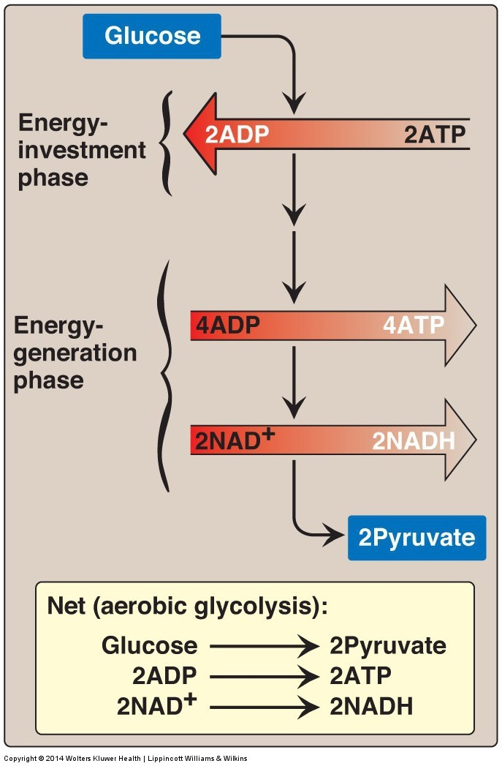
Glycolysis
Main pathway of monosaccharide degradation
Main tissue sites
Liver, muscle
Occurs in cytoplasm of the cell
Glucose conversion to two 3-carbon products: pyruvate
Generates 2 x ATP
Generates 2 x NADH => 6 ATP

Slide 84
Staring with the End – What happens to the Pyruvate
Aerobic Conditions
Becomes Acetyl-CoA
In presence of CHO but need energy -> TCA Cycle
In presence of CHO but don’t need energy -> Lipids
In absence of CHO (relevant for lipid oxidation)
Ketone Bodies (if OAA absent)
Gluconeogenesis (if OAA present)
Anaerobic conditions
Becomes lactate
Lactate goes to liver for reconversion back to glucose
Notes:
Absent of CHO is mo

Slide 85
Case Study – Tarui’s Disease
Mutation in phosphofructokinase 1
Rare ~100 cases
Autosomal recessive disease
Spend a moment thinking what would be the results of this disease

Slide 86
Case Study – Tarui’s Disease
Mutation in phosphofructokinase 1
Discuss some of these aspects among small groups
How would this affect the ability to use glucose for energy?
What would happen to glycogen levels?
What energy sources would be used instead?
What would happen to Fructose-2,6-bisphosphate levels?
Would it affect fructose utilization?

Slide 87
How would this affect the ability to use glucose for energy?
Would make it difficult
Would make it easy
Would have no effect

Slide 88
What would happen to glycogen levels?
More glycogen
Less glycogen
The same amount

Slide 89
What energy sources would be ok?
Fructose, Lipids and Amino Acids
Lipids and Amino Acids
Only Lipids
Only Amino Acids

Slide 90
Case Study – Tarui’s Disease
Mutation in phosphofructokinase 1 in muscle only
Discuss some of these aspects among small groups
How would this affect muscle function?
Would this be different from a mutation in the liver PFK1 enzyme?
What would you recommend for treatment

Slide 91
Tarui’s Disease Summary
Symptoms | Treatments
Glycogen accumulation (GSDVII) | Genetic testing
Muscle pain and cramps | Avoid anaerobic exercise
Muscle tissue degradation | Low glucose/galactose
Low muscle tone (hypotonia) | High protein diets
Cardiomyopathy

Slide 92
Uncommon… or is it?
2.8% frequency (8.6% in African population)
Only ~100 cases diagnoses
78/627784 homozygous individuals -> 1:804
Explore other variants on bravo.sph.umich.edu

Slide 93
Tissue Specific Roles of Glycolysis

Slide 94
Glucagon and adrenaline suppress glycolysis
Why would this be useful in the liver?
Why would this be counterproductive in the muscle?
Glucagon
Adrenaline
Liver
Glycolysis
Muscle
Glycolysis
This is done by phosphorylation and inactivation of PFK2 by cAMP/PKA signaling

Slide 95
How does glucagon/adrenaline inhibit PFK-2 activity in liver not muscle
Muscle doesn’t have PFK-2 activity
Glucagon/Adrenaline do not activate PKA in muscle
Muscle PFK-2 can’t be phosphorylated by PKA
There are no Glucagon/Adrenaline receptors in muscle

Slide 96
Tissue Specificity in PFK2 Regulation
Glucagon/Adrenaline can phosphorylate and inhibit Liver PFK2 but not Muscle PFK2
PFK-2 isoforms
Pourquoi?

Slide 97
The third regulated step in glycolysis is Pyruvate Kinase
Substrate mediated ADP phosphorylation
Notes:
Other example of substrate mediated phosphorylation is phosphoglycerate kinase

Slide 98
Pyruvate Kinase is Regulated by ATP, Fructose-1,6-bisphosphate and Alanine Levels
ATP – less glycolysis when energy levels are high
F16bP – more glycolysis when buildup of upstream substrates
Alanine – less glycolysis when abundance of amino acids

Slide 99
The Important Role of Alanine
Alanine is an important amino acid catabolite
Many amino acids degrade to alanine
All but Gly, Ser and Thr

Slide 100
Post-Translational Regulation of Pyruvate Kinase
Glucagon and
Adrenaline in the Liver

Slide 101
Tissue Specific Regulation of Glycolysis Summary
Component | Liver | Muscle
Glucokinase/Hexokinase | Not inhibited by G6P | Inhibited by G6P
Phosphofructokinase | Inhibition of PFK-2 (regulates via F26bP) | PFK-2 not inhibited by phosphorylation
Pyruvate Kinase | Inhibition of PK by alanine and by phosphorylation | PK not inhibited by alanine or phosphorylation

Slide 102
Chronic Regulation of GK/HK, PFK1 and PK Promotes Glycolysis
Hypoxia (HIF)
Carbohydrate levels (ChREBP – L-PK)
Chronic glucagon (CREB - GK)

Slide 103
How would hypoxia alter glycolysis?
Increase its efficiency
Decrease its efficiency

Slide 104
TCA Cycle Net ATP

Slide 105
Fructose and Galactose

Slide 106
Galactolysis

Slide 107
Disorders of Galatolysis
GALT (type I)
1:30,000-60,000
UDP-Galactose Epimerase (type II)
<1:100000
Galactose is trapped in the cell, builds up and causes developmental problems, cataracts, lethargy and liver damage
Avoid lactose and other galactose containing products

Slide 108
Liver Fructose Metabolism

Slide 109
Fructose Consumption and Metabolic Health

Slide 110
High Fructose Corn Syrup

Slide 111
Fructose metabolism
How is fructose metabolism different from glucose and galactose?
Think in terms of how it feeds into glycolysis
What metabolic checkpoints control glucose/galactose but not fructose?
What signals can regulate glucose/galactose but not fructose?

Slide 112
Regulators of Glycolysis/Fructolysis in Liver
Citrate is important here:
Part of TCA cycle (signals anaplerosis)
Part of lipogenesis (substrate and activates ACC)
Fructose is disengaged from citrate control from both

Slide 113
Inherited Disorders of Fructose Metabolism
Fructokinase mutations
Fructose not trapped in the cell
Elevated fructose in the blood
Generally not pathological
Aldolase B mutations
Buildup of Fructose-1-phosphate
Impaired gluconeogenesis and glycogenolysis
High risk of hypoglycemia

Slide 114
Glycolysis Learning Objectives
Describe the relative roles of glycolysis, gluconeogenesis, the TCA cycle as central nodes of nutrient metabolism.
Explain the catalytic differences and tissue distributions of glucokinase vs hexokinase and why this is important.
Understand how ATP is produced from glycolysis, and the efficiency of aerobic vs non-aerobic glycolysis
Understand the key points of regulation of glycolysis and how these regulatory points are controlled, notably how glucokinase/hexokinase, PFK1 and PK are regulated including what signals are important in what tissues.
Describe the potential fates of pyruvate, and what dictates the next steps in its metabolism
Explain how non-glucose carbohydrates such as galactose and fructose enter glycolysis, and how their point of entry affects how they are regulated.

